Slide 1
Flight Price Prediction System
Shri Shankaracharya Institute of Professional Management & Technology, Raipur
Minor Project Report on
CSE 7th Semester
Department of Computer Science and Engineering,
Batch 2018-2022
Session July – Dec 2021
Presentation Date:
Project Group Members:
Aisha Agrawal
Jagriti Verma
Srishti Xalxo
Project Guide
Prof. Ms. Kaveri Kar
(Assistant Professor , CSE Department)

Slide 2
Application Area
Nowadays, airline ticket prices can vary dynamically and significantly for the same flight, even for nearby seats within the same cabin. Customers are seeking to get the lowest price while airlines are trying to keep their overall revenue as high as possible and maximize their profit. Airlines use various kinds of computational techniques to increase their revenue such as demand prediction and price discrimination. From the customer side, two kinds of models are proposed by different researchers to save money for customers.

Slide 3
Project Overview
Flight price prediction , By our project we are trying to help people by providing them best deals for flight booking. They can compare among different flights and choose the one which is suitable according to their time and place so basically this will help our clients to have budget friendly trips

Slide 4
Project Requirements (Developer)
Software’s Required
Visual studio , Google collab , Microsoft excel , Anaconda Navigator
Hardware Required
Computer , CPU( i3 above processor , RAM 4gb and above)
Stable internet connection .

Slide 5
Project Requirements (End User)
Software’s Required
Chrome latest version ,
Operating systems- Windows* 7 or later, macOS, and Linux
Python* versions: 2.7.X, 3.6.X, 3.7 X, 3.8 X
Hardware Required
Computer , CPU (i3 above processor , RAM 4gb and above)
Stable internet connection .

Slide 6
Back End Details
Software:
Python , Microsoft excel .
Hardware:
Computer , CPU( i3 above processor , RAM 4gb and above)
Stable internet connection .

Slide 7
Database Details
Table Name:
Price list , Dept Day.
Attributes:
groupID , Dept_Day , Daystodep , Count , Total_meanFare ,
Total_minFare , Total_25Fare , Total_sdFare , Total_custoFare

Slide 8
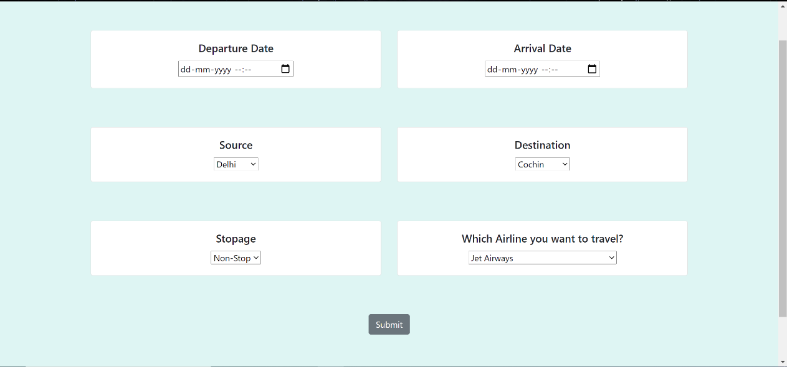
Front End Details
How many Interfaces / Screens your Application will have?
How each Interface / Screens will look like?
(Include Actual built Front End if available or make Hand Sketches)

Slide 9
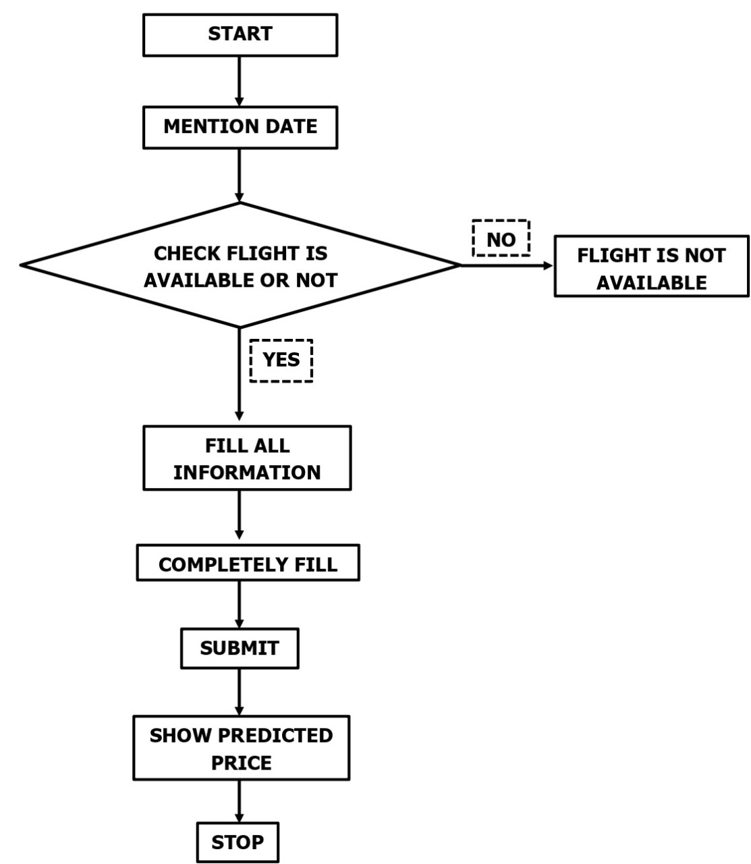
Project Flow Diagram

Slide 10
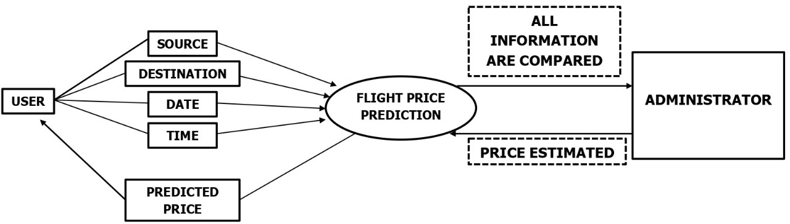
Data Flow Diagram

Slide 11
SNAPSHOT (GUI/INTERFACE)
Snapshot of your Project Interface.

Slide 12
Result & Conclusion
Shows your Project outcomes
This project will help the clients to book flights at best price
How this Project is going to help your Institute or Society or any specific group of people
This project will help our society by getting them best deals for flight booking

Slide 13
References
Text Book
Toby Velte, Anthony Vote and Robert Elsenpeter, “Cloud Computing: A Practical Approach”, McGraw Hill, 2002
Web Resources
http://www.stackoverflow.com
http://www.slideshare.com/androidintro.ppt
http://www.sharepdf.com/java1.6help.pdf

